Slide 1
Clustering Solar Energy Production Zones….
Project by: Subodh Kumar
Domain: Data Science & Artificial Intelligence

Slide 2

Project Overview
Objective:
To cluster geographical regions based on solar energy production.
Benefits:
Strategic targeting
Improved project feasibility
Data-driven decision making

Slide 3
Data Collection
Data Preprocessing
Feature Engineering
Data Scaling
Clustering Model
Visualization
Business Insights
Evaluation
Conclusion
Project Workflow

Slide 4

PROBLEM STATEMENT
To analyze historical data of existing solar power projects across different geographical regions.
To group geographical areas into meaningful clusters based on their total solar energy generation.
To identify hidden patterns and similarities in solar energy production using machine learning techniques.
To enable better understanding of solar resource distribution across the region.
To support strategic business planning by identifying high-potential solar energy zones.
To provide a data-driven framework for improving project feasibility and operational efficiency.
To visualize the clustered regions using interactive geographic maps for easy interpretation.

Slide 5

DATA PREPROCESSING
Loaded and inspected the raw solar energy dataset for structure and quality.
Cleaned column names to remove extra spaces and formatting inconsistencies.
Handled missing and null values by removing incomplete records.
Selected relevant features:
Latitude
Longitude
Expected Annual Energy Generation (MWh)
Removed duplicate and inconsistent data entries.
Performed feature scaling using StandardScaler to normalize the data.
Prepared a clean and standardized dataset for clustering model implementation.

Slide 6

FEATURE ENGINEERING
Identified and selected relevant features impacting solar energy production.
Extracted geographical coordinates (Latitude & Longitude) to capture spatial distribution.
Selected Expected Annual Energy Generation (MWh) as the key production indicator.
Removed non-essential attributes such as project names, addresses, and identifiers.
Handled missing and inconsistent values to ensure data reliability.
Constructed a structured numerical feature matrix for clustering analysis.
Applied feature scaling to maintain uniform contribution of all variables.

Slide 7

DATA SCALING…..
Observed significant differences in the range and magnitude of selected features.
Applied StandardScaler to normalize all numerical features.
Transformed features to have zero mean and unit variance.
Prevented dominance of high-magnitude features in clustering.
Improved distance-based clustering accuracy.
Ensured fair contribution of all variables to the model.
Prepared standardized input data for optimal clustering performance.

Slide 8

CLUSTERING MODEL/METHODOLOGY..
Machine Learning Approach: The project uses K-Means clustering, an unsupervised machine learning algorithm, to group cities based on similar solar energy characteristics.
Why K-Means?
Computationally efficient
Suitable for numerical data
Easy to interpret clusters
Number of Clusters:
Three clusters were selected to represent High, Emerging, and Low energy zones.

Slide 9
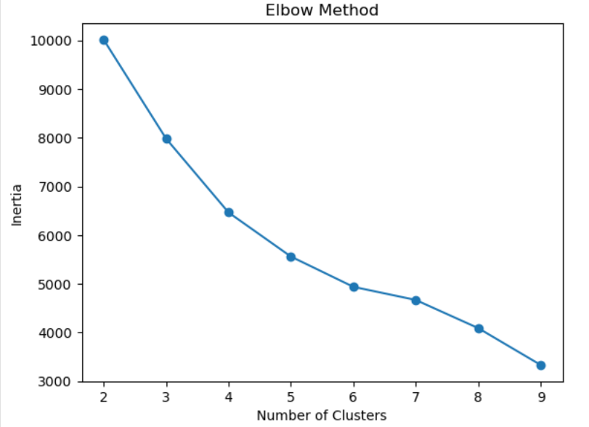
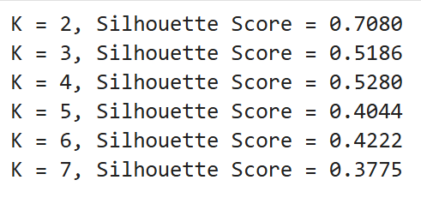
MODEL EVALUATION…
Evaluation techinques used:
Evaluated clustering performance using Elbow Method to identify optimal number of clusters.
Applied Silhouette Score to measure cluster compactness and separation.
Evaluation outcomes:
Compared clustering results across multiple values of K.
Selected K = 4 as the optimal cluster configuration based on evaluation metrics.
Verified cluster stability through multiple model initializations.
Analyzed intra-cluster similarity and inter-cluster separation.

Slide 10
VISUALIZATION-PYTHON BASED PLOTS & MAPS..
Purpose of Visualization: Visualization helps in understanding complex data patterns and validating clustering results visually.
Types of Visualizations Used:
Bar charts for comparing energy production across clusters
Scatter plots to analyze efficiency versus capacity
Heatmaps to study correlations among features
Geographical maps to visualize city-wise energy clusters
Outcome: Clear visual interpretation of energy zones and cluster behavior.

Slide 11
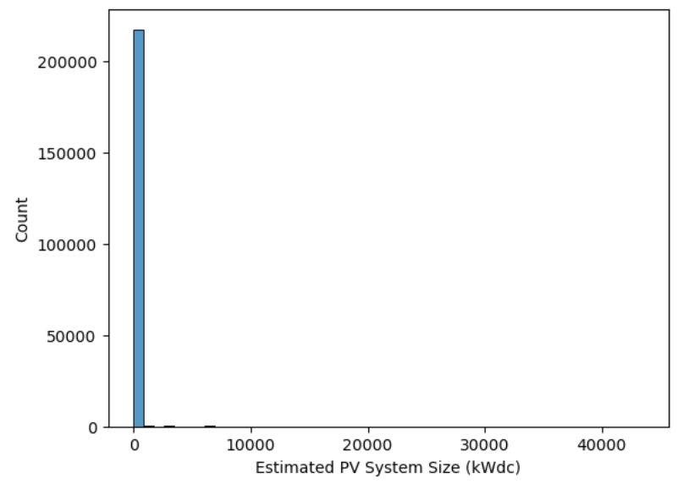
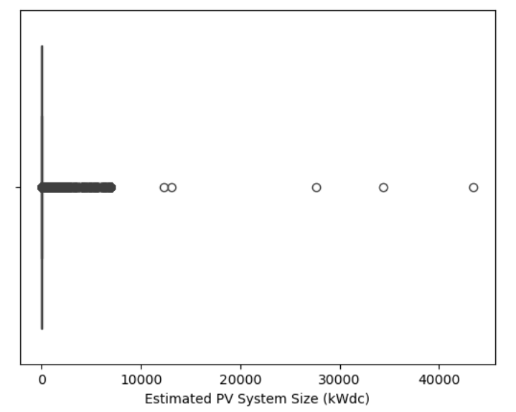
VISUALIZATION – PYTHON-BASED PLOTS & MAPS.
The distribution of Estimated PV System Size (kWdc) is highly right-skewed.
Most of the solar installations are small-scale systems concentrated at lower capacity values.
A very small number of projects have extremely large system sizes, creating a long right tail in the distribution.

Slide 12
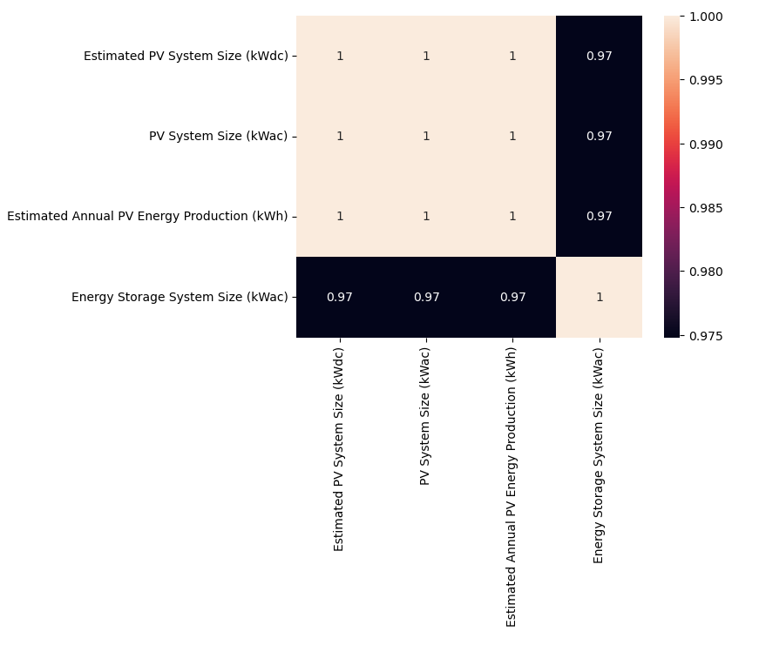
VISUALIZATION – PYTHON-BASED PLOTS & MAPS.
The heatmap represents the correlation matrix between key numerical features of the solar energy dataset.
It shows very strong positive correlations (≈ 0.97 – 1.00) among:
Estimated PV System Size (kWdc)
PV System Size (kWac)
Estimated Annual PV Energy Production (kWh)
Energy Storage System Size (kWac)
This indicates that as system size increases, energy production and storage capacity also increase proportionally.
Demonstrates feature dependency and redundancy, meaning these variables carry similar information.

Slide 13
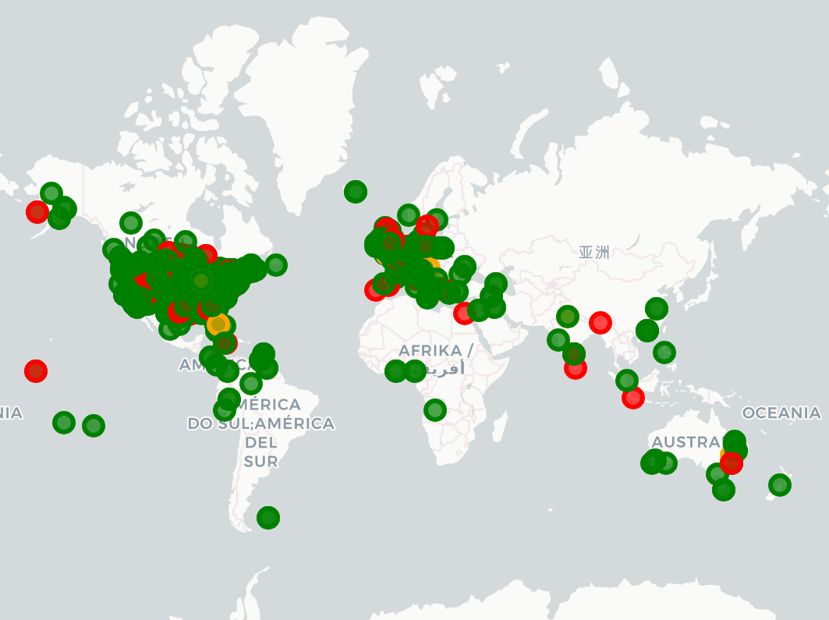
CLUSTER INTERPRETATION
High Energy Zone:
High solar energy production
Efficient utilization of installed capacity
Emerging Zone:
Moderate energy output
High potential for growth with optimization
Low Energy Zone:
Low energy production
Requires efficiency improvement and performance analysis
🟢 Green points → High & very high energy production zones.
🔴 Red points → Medium production zones.
🟡 Yellow / Orange points → Low production zones.

Slide 14
BUSSINESS INSIGHTS
Key Insights delivered:
Identified high solar energy production zones suitable for large-scale investments.
Identification of high ROI zones.
Supported data-driven site selection for future solar power projects.
Helped prioritize infrastructure development in high and medium potential zones.
Reduced financial risk by avoiding low-yield regions for large capital deployment.
Optimized resource allocation.
Strengthened market expansion and business growth strategies.

Slide 15
CONCLUSION…
Successfully implemented machine learning-based clustering to identify solar energy production zones.
Grouped geographical regions into distinct clusters based on energy generation and spatial distribution.
Identified high, medium, and low solar potential regions, enabling strategic planning.
Interactive map visualization provided clear geographic insights into solar deployment patterns.
The project supports data-driven decision making for site selection and investment planning.
Results help in optimizing resource allocation and maximizing return on investment (ROI).
Overall, the solution delivers actionable business insights for future solar project development.

Slide 16
THANK YOU…

